Slide 1
Lecture 04. Exception handling and debugging
Robotic Process Automation
[24 October 2023]
Elective Course, 2023-2024, Fall Semester
Camelia Chisăliţă-Creţu, Lecturer PhD
Babeş-Bolyai University

Slide 2

Acknowledgements
This course is presented to our Faculty with the support of UiPath Romania.

Slide 3
Contents
Errors
Exception
Types
Business Exception
System Exception
Error Handling Approaches
Try Catch
Demo1
Throw
Demo2
Rethrow
Demo2
Retry Scope
Demo3
Global Exception Handler
Demo4
Continue On Error
Demo5
Debugging
Steps to Apply
Tools
Locals Panel
Output Panel
Properties Inspector Panel
Techniques
Setting Breakpoints
Step Into & Step Over
Slow Step & Log Activities
Best Guidelines for Error Handling
References

Slide 4

Errors. Details
Error is
an event that obstruct the regular execution of the program;
based on their source, there are different types of errors:
Syntax errors
User errors
Programming errors (bugs)
Where the compiler/interpreter cannot parse the written code into meaningful computer instructions
Where the software determines that the user’s input is not acceptable for some reason
Where the program contains no syntax errors but does not produce the expected results
Notes:
An error is any type of event that prevents the regular execution of a program. Some of the errors completely stop the execution, others delay it, and others just interfere with them, without having a clear impact.
Based on their source, there are different types of errors:
Syntax errors, where the compiler/interpreter cannot parse the written code into meaningful computer instructions.
User errors, where the software determines that the user’s input is not acceptable for some reason.
Programming errors, where the program contains no syntax errors but does not produce the expected results. This are often called bugs.

Slide 5
Exceptions. Details
Exception is
an event that interrupts the normal flow of instructions while executing a program;
a type of error that is recognized (caught) by the program, categorized and handled;
it refers to the amount of deviation in the output shown from the required business or the agreed process.
some general exceptions are:
time exceptions,
I/O exceptions,
user exceptions,
class exceptions.
Notes:
Exceptions are a subset of errors that are serious enough to produce a material effect and for which there can be a mechanism to identify and address them. Exception handling mechanism refers to how to prevent and/or respond to exceptions. Sometimes, the handling mechanism can be simply stopping the execution. Some of the exceptions are linked to the systems used, while others are linked to the logic of the business process.
The types of exceptions are:
Application (System) Exception:
Describes an error rooted in a technical issue, such as an application that is not responding.
Has a chance of being solved simply by retrying the transaction, as the application can unfreeze.
Can be managed by following good naming conventions for activities and workflows. This helps in tracking the activity that caused the exception.
Business Exception:
Describes an error rooted in the fact that certain data which the automation project depends on is incomplete, missing, outside of set boundaries or does not pass other data validation criteria.
It is an exception from the usual process flow and the validation is made explicitly by the developer inside the workflow.
The text in the exception should contain enough information for a human user (business user or developer) to understand what happened and what actions need to be taken.

Slide 6
Exception. Types
In UiPath there are two types of exceptions:
Business Exception
An exception that occurs in the business process is called a business exception.
System Exception
The disruption caused due to a system failure is called a system exception.
Notes:
In UiPath, there are basically two types of exceptions:
Business Exception
System Exception

Slide 7
Business Exception. Details
Business rule is
a set of specific instructions on how the input and output of data should be processed in order to achieve a meaningful business result;
Business exception is
any deviation from the standard business rule in a process or activity;
dependent on the type of business;
E.g.: if the subject of an email is not standard and keeps on changing, the Robot will not be able to pick it; this results in a business exception;
solution:
to avoid the business exception the business process needs to be understood very carefully.
Notes:
Business Exception
The exception that occurs in a business process is called a business exception. The exception is dependent on the type of business. When an exception is caused due to the current working structure, it is termed as business exception.
Example:
If we have to download an attachment from an email, then we need to have a unique identifier. If the subject of the email is not standard and keeps on changing the robot will not able to pick and this will result in a business exception. Any deviation from the standard business rule in any process or activity is called business exception. Hence to avoid the business exception we need to understand the business process very carefully.
Business Rule:
In RPA, business rule is defined as a set of specific instructions on how the input and output of data should be processed.

Slide 8
System Exception. Details
System exception (error) occurs
when the normal flow of the automation process is stopped due to the failure of system;
E.g.: if Outlook is not working, the Robot will not be able to open any attachment. This is categorized as system error;
the error caused is due to Microsoft Outlook failure and is not related to the programming of the business rule, hence this is categorized as system error;
solution:
a system error can be minimized by making the code error proof.
Notes:
System Exception
Every business process that we automate requires different applications and tools such as Microsoft office, SAP ERP, CRM, Oracle and many more. When the normal flow of the automation process is disrupted or stopped due to the failure of system, this is called system exception.
Example:
It is mandatory to have Microsoft outlook to automate a business process. The Robot picks the attachment from an email and then downloads the same. If the outlook is not working, the robot will not be able to open the attachment. The error caused is due to Microsoft outlook failure and has nothing to do with the programming or business rule hence this is categorized as System error.
A System error can be minimized by making the code error proof.

Slide 9
Error Handling Approaches
it is common for automation projects to encounter events that interrupt or interfere with the projected execution.​
Actions executed when exceptions are caught:​
Stopping the execution​;
Executing automatically explicit actions within the workflow​;
Escalating/sending the issue to a human operator.
Global Exception Handler
Global level
Try Catch, Throw, Rethrow or Retry Scope or
Continue On Error
Activity Level
Notes:
It is common for automation projects to encounter events that interrupt or interfere with the projected execution.​
​
A good project design will include ways of recognizing and categorizing the exception, and patterns of action that are executed only when exceptions are caught:​
Simply stopping the execution​
Executing automatically explicit actions within the workflow​
Escalating the issue to a human operator
​
Predicting and treating exceptions can be done in two ways:​
At activity level: Using Try/Catch or Retry Scope;
At a global level: Using the Global Exception Handler.

Slide 10
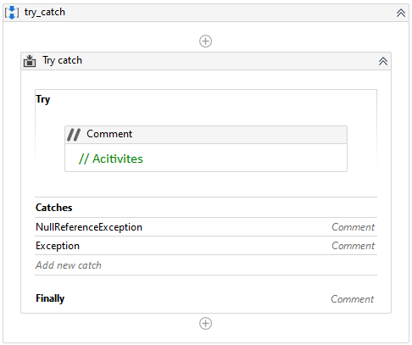
Try Catch Activity. Details
in every automation process, user want to be able to detect the errors as they happen and perform various actions to rectify the errors when they occur;
Try Catch activity
is used to enable the program to recover from specific error instead of crashing and terminating the whole workflow;
represents a reliable method available in UiPath to identify the reason of failure.
see Demo1 – TryCatchFinally
Notes:
Catching Errors:
This is the remedial method used in UiPath studio to identify the reason of failure and detect the error. One of the most reliable method that we use in UiPath is Try Catch activity. In every automation process, user want to be able to detect the errors as they happen and perform various actions to rectify the errors when they occur.
1. Try-Catch Activity
It is used to recover from specific error instead of crashing and terminating the whole workflow. The Try-Catch activity can be found in the activities panel. To use Try-Catch activity, we will drag and drop it inside the workflow.

Slide 11
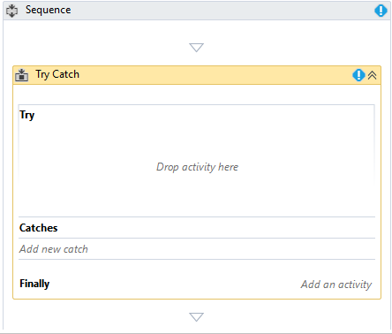
Try Catch Activity. Components
for handling errors in Try Catch block, the workflow is divided into 3 parts:
Try Block
all the possible activities that can create or cause error should be placed in this block;
Catches Block
the user can add multiple type of catches in this block;
the clause name is “Catches” in UiPath;
Finally Block
it is used for the actions to be performed after the Try-Catch blocks;
it is executed in case of an error or no error is caught in the Catches block.
see Demo1 – TryCatchFinally
Notes:
For handling errors in Try Catch block, the user has to divide the whole workflow into 3 parts:
Try Block: In this, the user has to put all the activities that might throw an error. All the possible activities which you create that cause error that's why it should be placed in the blocks
Catch Block: This is another very important activity to remove the errors. It is actually called “Catches” in UiPath since user can add multiple type of catches.
Finally (Optional one): It is just for the actions to be performed after the try & catch blocks. In case of error or no error still the finally bock will be executed.

Slide 12
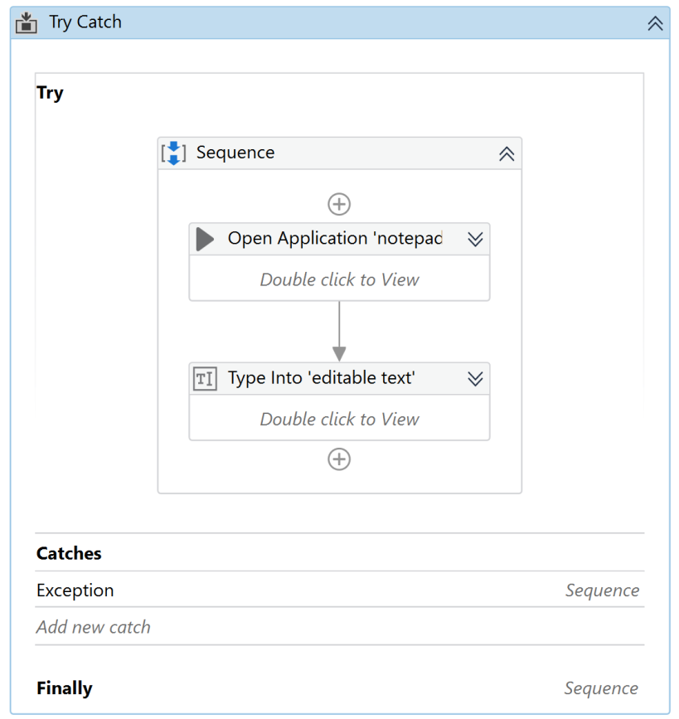
Demo1. Try Catch Activity
Design a workflow that attempts to execute the following steps:
1. opens the file File1.txt
2. fills in the text “Hello, dear friend!”
3. fills in the text “Have a nice day!” ---> issue
Goals: emphasize the use of Try Catch activity by:
Including the desired steps into the Try component;
Handling any exception occurred by presenting using the MessageBox activity the exception message inside the Catch component;
Closing the workflow with particular action for the Finally component.
see Demo1 – TryCatchFinally
Notes:
For handling errors in Try Catch block, the user has to divide the whole workflow into 3 parts:
Try Block: In this, the user has to put all the activities that might throw an error. All the possible activities which you create that cause error that's why it should be placed in the blocks
Catch Block: This is another very important activity to remove the errors. It is actually called “Catches” in UiPath since user can add multiple type of catches.
Finally (Optional one): It is just for the actions to be performed after the try & catch blocks. In case of error or no error still the finally bock will be executed.

Slide 13
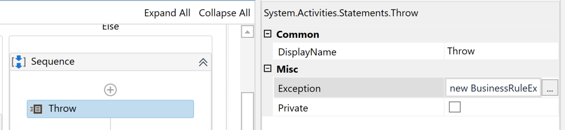
Throw Activity. Details
Throw activity is
used to throw a specific type of exception that the user intends to expose;
the Catches block handles that particular type of exception and performs a specific action intended by the user for that special circumstances.
see Demo2 – ThrowRethrow
Notes:
Throw Activity:
It is used to throw specific type of exception that user want to throw and in the catch it can handle that particular type of exception and perform action that user wants to perform on that exception.

Slide 14
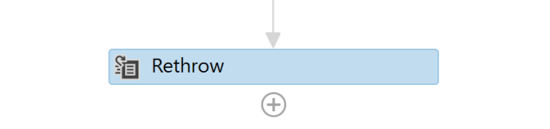
Rethrow Activity. Details
Rethrow activity is
used to clear an exception;
it is similar to the Throw activity and can be used in Catches block.
see Demo2 – ThrowRethrow
Notes:
Step by Step procedure for example of Rethrow:
Create two variables with the name “a” and “b” of type integer and pass the values a =12, b =24.
Drag and drop the Try-Catch activity inside it and drag and drop one more try catch activity.

Slide 15
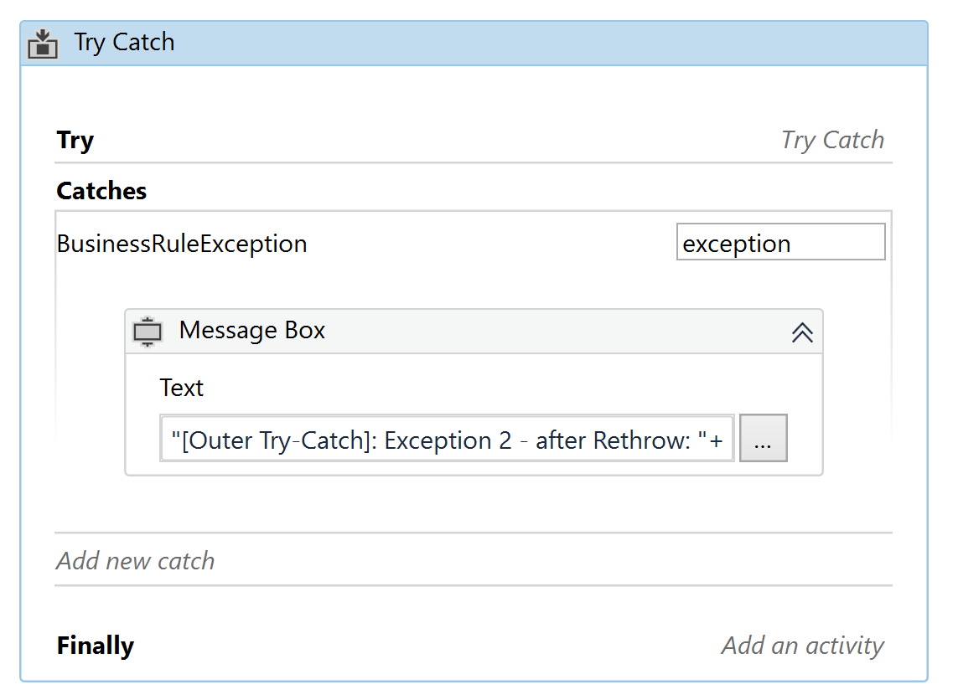
Demo2. Throw, Rethrow Activities
Design a workflow that attempts to execute the following steps:
1. reads an integer number (nr1)
2. reads an integer number (nr2)
3. checks if n1 divides nr2, i.e., nr1 % nr2 == 0 (inner Try Catch activity)
if yes ==> a message is shown
if no ==> an exception is thrown, i.e., an object of type BusinessRuleException is created and thrown;
the inner Catch handles the exception by Rethrow-ing it again.
the outer Try Catch activity catches the exception within the Catch component and handles it.
see Demo2 – ThrowRethrow
Notes:
For handling errors in Try Catch block, the user has to divide the whole workflow into 3 parts:
Try Block: In this, the user has to put all the activities that might throw an error. All the possible activities which you create that cause error that's why it should be placed in the blocks
Catch Block: This is another very important activity to remove the errors. It is actually called “Catches” in UiPath since user can add multiple type of catches.
Finally (Optional one): It is just for the actions to be performed after the try & catch blocks. In case of error or no error still the finally bock will be executed.

Slide 16
Demo2. Try Catch, Throw, and Rethrow Activities
Design and implement a workflow that performs the following actions:
Reads data from a .xlsx file with the following structure:
Cash In, Cash Out, Result;
Throws an Exception in case Cash In and/or Cash Out are not numbers;
use Throw and Rethrow activities;
Computes the Result value based on the formula Cash In – Cash Out;
Saves the data in the same .xlsx file.
see Demo2.1 – ProfitComputationExcel

Slide 17
Retry Scope Activity. Details
Retry Scope activity
retries the contained activities as long as the condition is not met, or an error is thrown;
it is used to retry the execution in situations in which an error is expected. The execution will be retried until a certain event happens (for a number of times) or without any condition (for a number of times).
it is used for catching and handling an error, being similar to Try Catch with the difference that Retry Scope activity simply retries the execution without providing a more complex handling mechanism.
see Demo3 – RetryScope
Notes:
Retry Scope activity retries the contained activities as long as the condition is not met, or an error is thrown.
It is used to retry the execution in situations in which an error is expected. The execution will be retried until a certain event happens (for a number of times) or without any condition (retried until no exception is thrown).
It is used for catching and handling an error, which is why it’s similar to Try Catch. The difference is that this activity simply retries the execution instead of providing a more complex handling mechanism.
Some of the properties of Retry Scope are:
NumberOfRetries - The number of times that the sequence is to be retried.
RetryInterval - Specifies the amount of time (in seconds) between each retry.
For example, consider a website that simply works faulty and the user just needs to click the same button over and over until it goes to the desired screen.

Slide 18
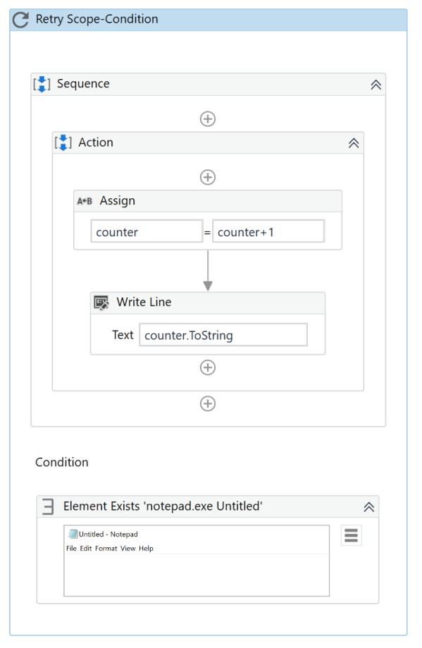
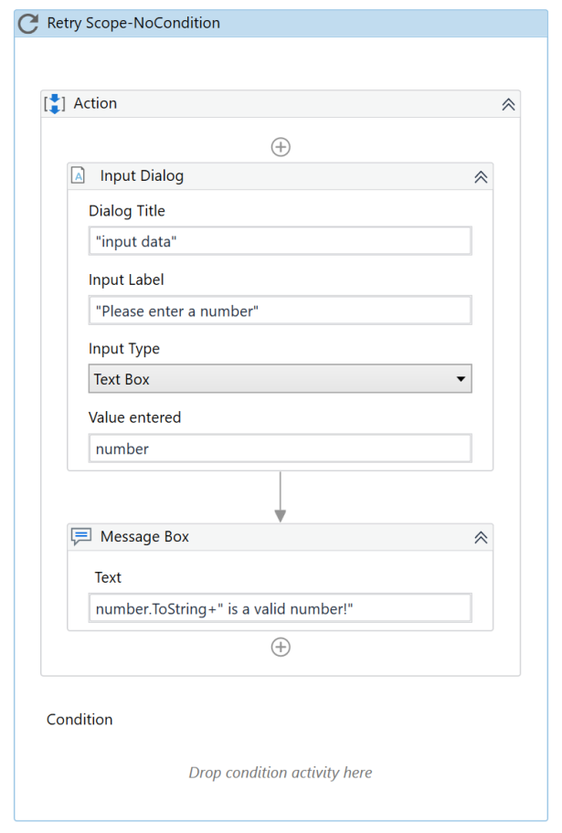
Demo3. Retry Scope Activity
Design a workflow that attempts to execute the following steps:
1. increases a counter;
the increase is conditioned by the existence of the Notepad app on the screen;
there are 3 attempts with 2 seconds retry interval;
it is combined with ContinueOnError property when the Notepad app is not available;
2. reads an integer number
there are 3 attempts with 4 seconds retry interval;
no condition is provided;
it is combined with the ContinueOnError property when no valid number is read after all attempts.
see Demo3 – Retry Scope
Notes:
For handling errors in Try Catch block, the user has to divide the whole workflow into 3 parts:
Try Block: In this, the user has to put all the activities that might throw an error. All the possible activities which you create that cause error that's why it should be placed in the blocks
Catch Block: This is another very important activity to remove the errors. It is actually called “Catches” in UiPath since user can add multiple type of catches.
Finally (Optional one): It is just for the actions to be performed after the try & catch blocks. In case of error or no error still the finally bock will be executed.

Slide 19
Global Exception Handler. Details
Global Exception Handler is
a predefined workflow used to handle all unhandled exception;
it has a predefined structure and behaviour that can be adapted:
predefined arguments;
predefined actions.
see Demo4 – GEH
Notes:
The Global Exception Handler has a predefined structure.
It has two predefined arguments (that shouldn't be removed):
errorInfo, with the In direction - contains the error that was thrown and the workflow that failed
result, with the Out direction - will store the next behavior of the process when it encounters the error
It contains two predefined actions (that can be removed, and other actions can be added):
Log Error: This part simply logs the error. The developer gets to choose the logging level: Fatal, Error, Warning, Info, and so on.
Choose Next Behavior: Here the developer can choose the action to be taken when an error is encountered during execution:
Continue - The exception is re-thrown
Ignore - The exception is ignored, and the execution continues from the next activity
Retry - The activity which threw the exception is retried
Abort - The execution stops after running the current handler

Slide 20
Global Exception Handler. Structure
there are two predefined arguments (should be kept):
errorInfo (In direction) - contains the error that was thrown and the workflow that failed;
result (Out direction) - will store the next behavior of the process when it encounters the error;
there are two predefined actions (can be removed, others can be added):
Log Error – used to log the error (Fatal, Error, Warning, Info, etc.);
Choose Next Behavior – the action chosen to be taken when an error is encountered during execution:
Continue - the exception is re-thrown;
Ignore - the exception is ignored, and the execution continues from the next activity;
Retry - the activity which threw the exception is retried;
Abort - the execution stops after running the current handler.
see Demo4 – GEH
Notes:
The Global Exception Handler has a predefined structure.
It has two predefined arguments (that shouldn't be removed):
errorInfo, with the In direction - contains the error that was thrown and the workflow that failed
result, with the Out direction - will store the next behavior of the process when it encounters the error
It contains two predefined actions (that can be removed, and other actions can be added):
Log Error: This part simply logs the error. The developer gets to choose the logging level: Fatal, Error, Warning, Info, and so on.
Choose Next Behavior: Here the developer can choose the action to be taken when an error is encountered during execution:
Continue - The exception is re-thrown
Ignore - The exception is ignored, and the execution continues from the next activity
Retry - The activity which threw the exception is retried
Abort - The execution stops after running the current handler

Slide 21
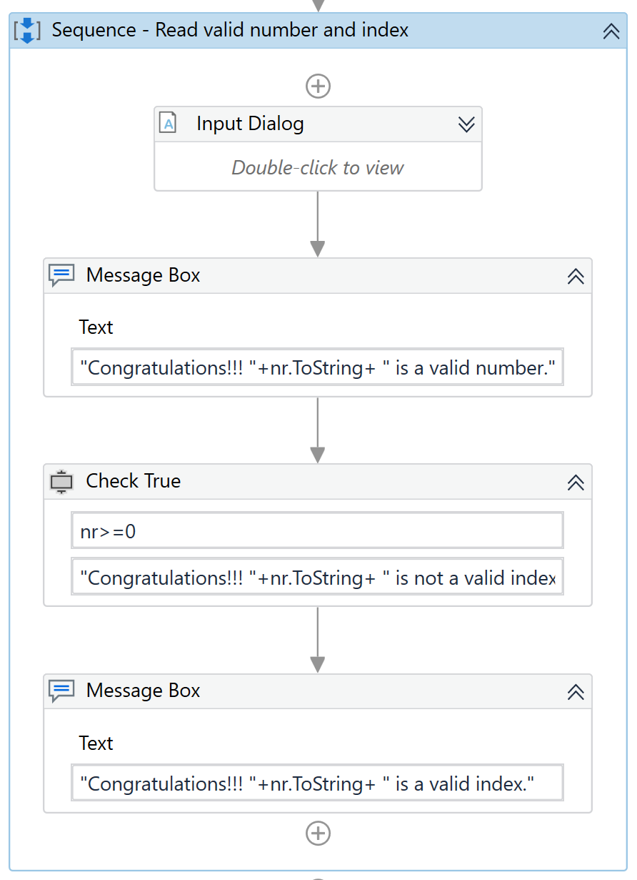
Demo4. GEH
Design a workflow that attempts to execute the following steps:
1. fills in some text in a file that should be opened;
there are 4 attempts to achieve the above task, otherwise an exception is thrown and the workflow ends;
after each attempt the task is retried.
2. reads an integer number (nr)
there are 4 attempts to read a valid number using the Input Dialog activity; after the 4th attempt an exception is thrown and the workflow ends.
3. checks if nr >= 0 using the Check True activity;
if the condition is False an exception is thrown; this check is performed 4 times before the workflow ends and the corresponding message is shown indicating whether nr is a valid index (>=0) or not (<0).
see Demo4 – GEH
Notes:
For handling errors in Try Catch block, the user has to divide the whole workflow into 3 parts:
Try Block: In this, the user has to put all the activities that might throw an error. All the possible activities which you create that cause error that's why it should be placed in the blocks
Catch Block: This is another very important activity to remove the errors. It is actually called “Catches” in UiPath since user can add multiple type of catches.
Finally (Optional one): It is just for the actions to be performed after the try & catch blocks. In case of error or no error still the finally bock will be executed.

Slide 22
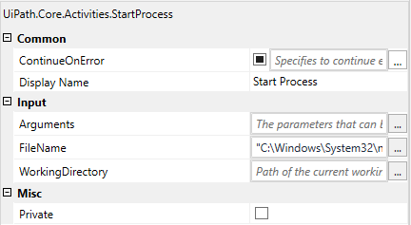
Continue On Error Activity Field (Property). Details
Continue On Error allows
to specify if the automation should continue, even if the activity throws an error.
useful for activities that work with UI interaction;
the field supports only Boolean values (True, False-default);
if this field is blank and an error is thrown, the execution of the project stops;
if the value is True, the execution of the project continues regardless of any error.
if it is set to True on an activity that has a scope (such as Attach Window or Attach Browser), then all the errors that occur in the activities inside that scope are also ignored.
recommended :
for data scraping – to avoid throwing an exception on the last page (when the selector of the 'Next' button is not found);
when the user is not interested in capturing the error, just to execute the activity.
see Demo5 – ContinueOnError
Notes:
Continue On Error is very useful for activities that work with UI interactions. It is the easiest way to tell the workflow to continue even if the activity throws an error.
This field only supports Boolean values (True, False). The default value in this field is False. As a result, if this field is blank and an error is thrown, the execution of the project stops. If the value is set to True, the execution of the project continues regardless of any error.
When it is set to True on an activity that has a scope (such as Attach Window or Attach Browser), then all the errors that occur in other activities inside that scope are also ignored.
It is used when:
Using data scraping, so that the activity doesn't throw an error on the last page (when the selector of the 'Next' button is no longer found);
The user is not interested in capturing the error, but simply in the execution of the activity.

Slide 23
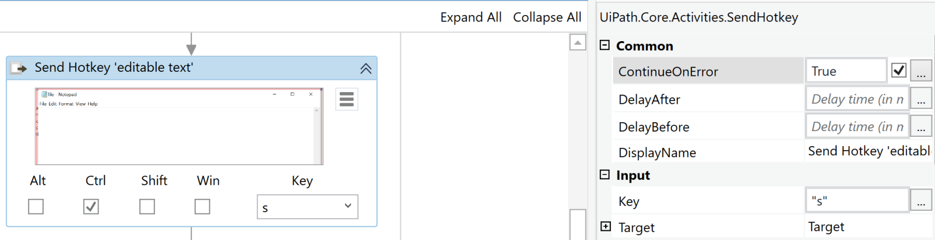
Demo5. Continue on Error Property
Design a workflow that attempts to execute the following steps:
1. fills in some text in a file that should be opened;
if the property ContinueOnError is set to False, when an exception is thrown the execution of the workflow ends;
if the property ContinueOnError is set to True, if an exception is thrown this is ignored and the execution of the workflow continues.
2. saves the files;
3. closes the file.
see Demo5 – ContinueOnError
Notes:
For handling errors in Try Catch block, the user has to divide the whole workflow into 3 parts:
Try Block: In this, the user has to put all the activities that might throw an error. All the possible activities which you create that cause error that's why it should be placed in the blocks
Catch Block: This is another very important activity to remove the errors. It is actually called “Catches” in UiPath since user can add multiple type of catches.
Finally (Optional one): It is just for the actions to be performed after the try & catch blocks. In case of error or no error still the finally bock will be executed.

Slide 24
Debugging. Details
Debugging
is the process of identifying error or bug in the running software or Robot;
ensures that the error is identified and resolved so that it does not impact the operation and running of the Robot;
is a multi-step process that ensures that the software works according to its requirements;
helps in maintaining the quality and continuity of the code by resolving the errors.
Notes:
The process of identifying error or bug in the running software or Robot is called debugging. It ensures that the error is identified and resolved so that it does not impact the operation and running of the robot. It is a multi-step process that ensures that the program to develop a software or application is perfect. Debugging helps in maintaining the quality and continuity of the code by resolving the errors.
There are multiple types of debugging methods such as interactive debugging, log file analysis, unit testing, control flow analysis, memory dumps, integration testing and profiling.
Validate is one of the key method used in UiPath to identify and resolve the error. This includes identification of the error causing element and then resolving them by following certain steps.
In RPA, there are six steps which are helpful in error handling:
Step Into and Step Over
Validate
Breakpoints
Slow Steps
Options
Logs Section

Slide 25
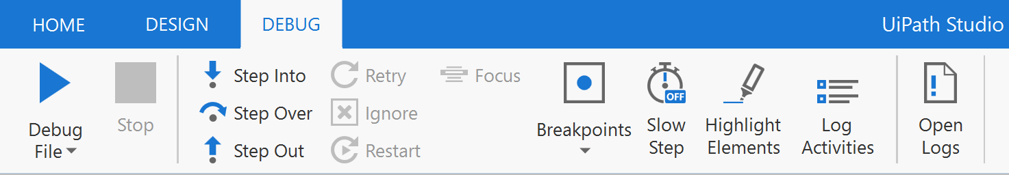
Debugging. Steps to Apply
In RPA, there are several steps which are helpful in error handling:
Step Into and Step Over;
Breakpoints;
Slow Steps;
Log Activities.
Notes:
The process of identifying error or bug in the running software or Robot is called debugging. It ensures that the error is identified and resolved so that it does not impact the operation and running of the robot. It is a multi-step process that ensures that the program to develop a software or application is perfect. Debugging helps in maintaining the quality and continuity of the code by resolving the errors.
There are multiple types of debugging methods such as interactive debugging, log file analysis, unit testing, control flow analysis, memory dumps, integration testing and profiling.
Validate is one of the key method used in UiPath to identify and resolve the error. This includes identification of the error causing element and then resolving them by following certain steps.
In RPA, there are six steps which are helpful in error handling:
Step Into and Step Over
Validate
Breakpoints
Slow Steps
Options
Logs Section

Slide 26
Debugging. Tools
on clicking Debug File, three panels appear on the workstation screen:
Locals Panel
Cross-references different HTML pages and documents
Properties Inspector Panel
Embeds managed components and windows form controls
Output Panel
The most commonly used tool for web page formatting
Debugging Tools
Notes:
It is the most important method by which developers identify the error or bugs in the developed code and make changes so that we can get error-free programs.
You can use “F7 key to run the debugging process and F9 key for breakpoint purpose”.
In the Robotic Process Automation, various tools have been provided by UiPath Studio for debugging. These tools are helpful to check the workflow of the programming structure and find the exception. Apart from this, debugging also helps in checking the execution process of each data that is validated or checked.
On Clicking “Start Debug”, three panels appear on the workstation screen:
Locals panel
Output panel
Properties Inspector Panel

Slide 27
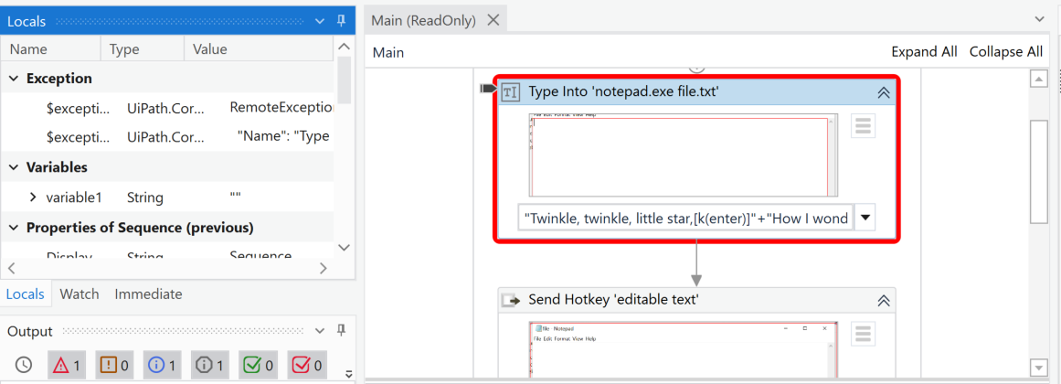
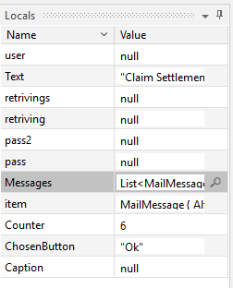
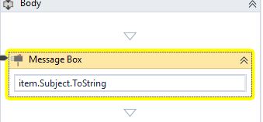
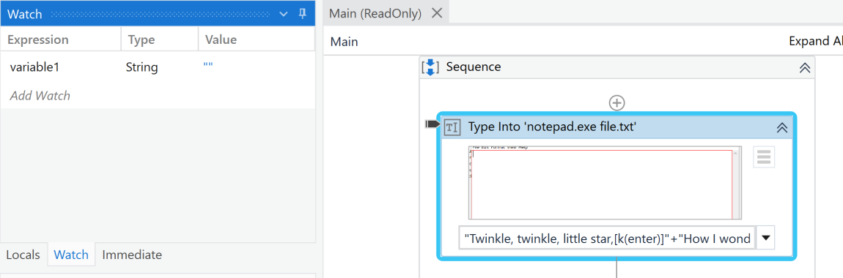
Locals Panel. Details
Locals Panel shows
the values of all the variables in the current scope and
highlights the currently executing activity in colour (red, yellow, blue).
Notes:
Local Panel:
Once we click on the break, a workflow (that holds the data variables) running in debugging mode appears on the screen. The local panel will show the values of all variables and highlight the recently executing activity in yellow colour which is helpful to find the data path. However, all these things can happen only when the data convention is assigned accurately.

Slide 28
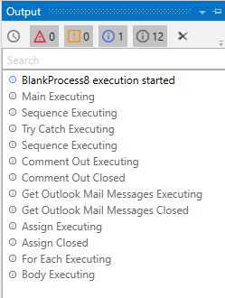
Output Panel. Details
Output Panel shows
the detailed log of the current stage of workflow and the status of all activities executed by the Robot.
Notes:
The Output Panel is an essential panel in the RPA debugging. It displays the detailed log of the current stage of workflow and the status of all activities executed by the Robot.

Slide 29
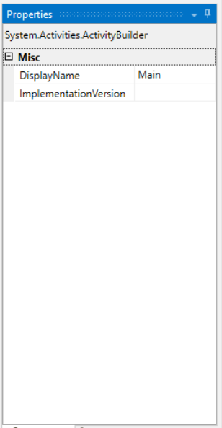
Properties Inspector Panel. Details
Properties Inspector Panel shows
the active action properties, variable values declaration and debugging in the given data scope.
Notes:
The Properties Inspector Panel is used to show the active action properties, variable values declaration and debugging in the given data scope.

Slide 30
Debugging Techniques. Details
Debugging is a feature embedded in UiPath Studio which can be accessed through the Execute Ribbon.
there are various techniques for debugging.
Setting Breakpoint
Slow Step
Methods and Techniques of Debugging
Highlight elements
Step Into
Step Over
Notes:
The Debugging is a feature embedded in UiPath Studio, which can be accessed through the Execute Ribbon.
The various techniques for debugging are:
Setting Breakpoint
Step Into
Step Over
Slow Step
Highlight elements

Slide 31
Setting Breakpoints. Details
Setting Breakpoints is
used when the user wants to pause the program at a specific location;
once the breakpoint is set to an activity, the program will run till that activity but not execute it; the execution is paused and the user can see the current value of the variables, the current state of workflow, identify and correct the error causing element failure.
the user can choose to Continue, Step Into, Step Over, Step Out or Stop the debugging process;
Steps to enable breakpoints:
Select the activity until the point which to execute in the project.
Right-click and choose toggle breakpoint.
the workflow can be continued by clicking on the Resume button which can start the breakpoint activity on the last activity basis.
Notes:
Setting Breakpoint
It is used when the user wants to pause the program at a specific location. Once we set the toggle breakpoint to an activity, the program will run till that activity but not execute it. Once the execution is paused, the user can see the current value of the variables, the current state of workflow, identify and correct the error causing element.
The user can choose to Continue, Step Into, Step Over, or Stop the debugging process.
Enable Breakpoint
Select the activity until the point which you don’t want to execute in the project.
Right-click and choose toggle breakpoint.
You can continue the activity by clicking on the resume button which can start your breakpoint activity on the last activity basis.

Slide 32
Step Into & Step Over. Details
Step Into is
used to start execution from the part where the user has indicated the breakpoint;
Step Over is
used to jump to the next activity from the part where the user has indicated the breakpoint;
Both activities cannot work simultaneously.
Notes:
Here we have mentioned techniques of Debugging which you can follow in the Debugging and Exception Handling process.
1. Step Into : It is used to start execution from the part where the user has indicated the breakpoint.
2. Step Over: It is used to jump to the next activity from the part where the user has indicated the breakpoint.
Note* Both the activities cannot work simultaneously, they can only work one by one. They are used only when the user has indicated a breakpoint.

Slide 33
Slow Step & Log Activities. Details
Slow Step is
used to reduce the execution speed of the process;
it helps the user to identify each activity and to see the changes of variable values after executing every activity;
it can be activated and deactivated while the workflow is running.
Log Activities allows
to list the activities that are executed while the debugging mode is on.
Notes:
3. Slow Step:
It is used to reduce the execution speed of the process. It helps the user to identify each and every activity and also see the changes in values of variables after executing every activity. It can be activated and deactivated while the workflow is running.
4. Highlight Elements:
It shows the effect of the current application over the other application element, while the debugging mode is on. This is only helpful for the input and output activities.

Slide 34
Best Guidelines for Error Handling
Analyzing the process thoroughly, identifying the requirements and planning
Handling sensitive data responsibly
Breaking the process into smaller workflows
Using Try/Catch blocks
Grouping the workflows of the project into different folders based on the target application
Using Global Exception Handler
Keeping consistent naming convention across the project
Using Libraries
Using the right type of argument (In/Out/InOut)
Adding annotations to the workflows
Notes:
3. Slow Step:
It is used to reduce the execution speed of the process. It helps the user to identify each and every activity and also see the changes in values of variables after executing every activity. It can be activated and deactivated while the workflow is running.
4. Highlight Elements:
It shows the effect of the current application over the other application element, while the debugging mode is on. This is only helpful for the input and output activities.

Slide 35
Next lecture
Lecture 05
UI Interactions;
Custom activities.

Slide 36
Next lecture
Lecture 06
UI Interactions;
Custom activities.

Slide 37
References
UiPath Docs - https://docs.uipath.com/
UiPath Studio Docs - https://docs.uipath.com/studio/standalone/2023.4
UiPath Forum - https://forum.uipath.com/
UiPath Academy - https://academy.uipath.com/

